Slide 1
FLORIDA APPEALS (For the non-appellate lawyer)

Slide 2
WHY DO WE CARE?

Slide 3
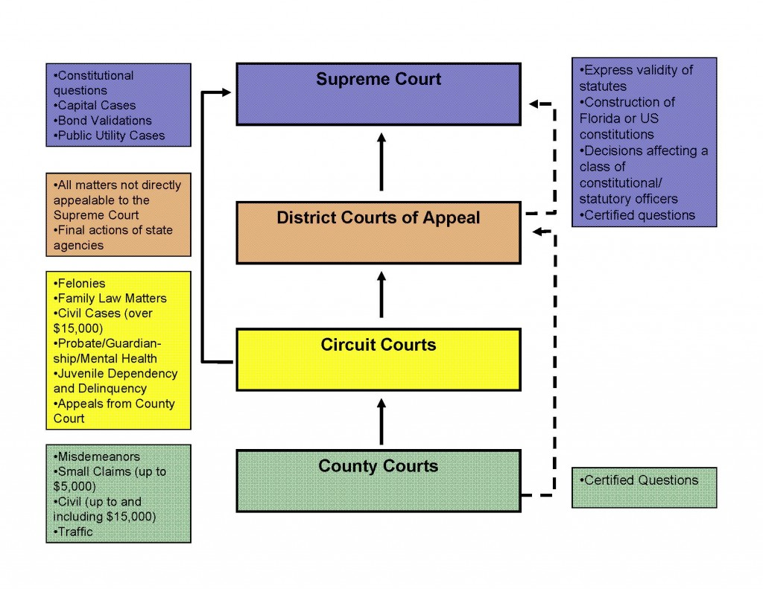
Notes:
QuickStarter has created an outline to help you get started on your presentation. Some slides include information here in the notes to provide additional topics for you to research.

Slide 4
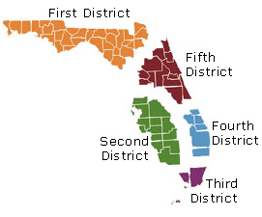
DISTRICT COURTS OF APPEAL
Notes:
QuickStarter has created an outline to help you get started on your presentation. Some slides include information here in the notes to provide additional topics for you to research.

Slide 5
Types of appeal
1. Final Appeal
2. Non-Final Appeal
3. Extraordinary Writ

Slide 6
FINAL APPEAL
Final Judgment
Dismissal of an Action
Partial Judgment on Distinct and Severable Cause of Action

Slide 7
Non-FINAL APPEAL
Authorized by Rule 9.130
Orders concerning venue and jurisdiction
Orders on class certification
Orders on motions for relief from judgment

Slide 8
Extraordinary writs
Mandamus- Command performance of ministerial duty
Prohibition- Prevent lower court from exercising jurisdiction
Certiorari- Failure to conform to the requirements of law, causing material injury
Habeas Corpus- Determine whether detention of an individual is legal

Slide 9
Anatomy of an appeal
1. Adverse Ruling
2. Filing of Notice of Appeal
3. Preparation of the Record
4. Briefing
5. Oral Argument
6. Ruling

Slide 10
PRESERVATION OF ERROR
1. Timely, Contemporaneous Objection
2. Stated Legal Basis
3. Obtain an Adverse Ruling on Objection

Slide 11
STANDARDS OF REVIEW
De Novo (no deference to trial court’s legal conclusions)
Pure Questions of Law
Order Granting Summary Judgment
Order Granting Motion to Dismiss
Competent, Substantial Evidence
Trial Court Findings of Fact
Abuse of Discretion (no reasonable man)
Rulings on Admissibility of Evidence
Order on Motion to Vacate Default
Order on Motion to Vacate Judgment

Slide 12
Practice tips
Weigh the benefits of summary judgment against the risks of reversal on appeal
When in doubt about preservation of record, ask for a more specific ruling
Bring a court reporter
Don’t try to do it on your own

Slide 13
“appellate judges watch from on high the legal battle fought below, and when the dust and smoke of the battle clears they come down out of the hills and shoot the wounded.” -Judge KENNY Griffis, MISSISSIPPI COURT OF APPEALS (WITH CREDIT TO JUSTICE John F. Onion, Jr., Texas Court of Criminal Appeals)

